Slide 1

Website Hosting in Azure
This presentation, by Adharsh, explores hosting a dynamic website in Azure. It covers the project overview, tech stack, features, and deployment process. Discover the power of Azure for modern web applications!

Slide 2


Introduction
This project showcases a dynamic website with user registration and content pages. It illustrates Azure's hosting capabilities for web applications. It solves the need for scalable and reliable hosting.
Project Overview
Purpose
Dynamic website with user registration.
Illustrate Azure hosting capabilities.
Problem Solved
Scalable hosting solution.

Slide 3
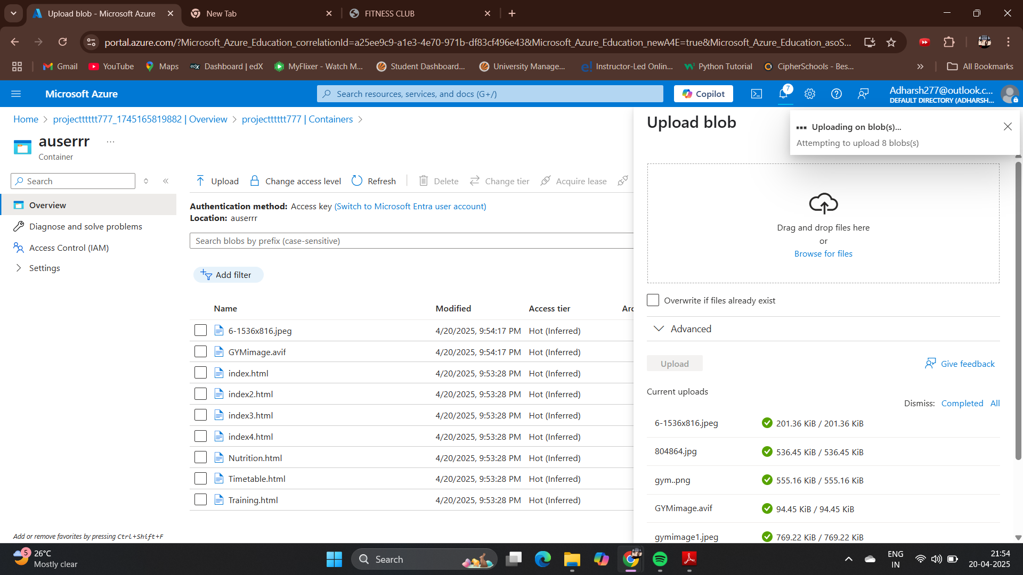
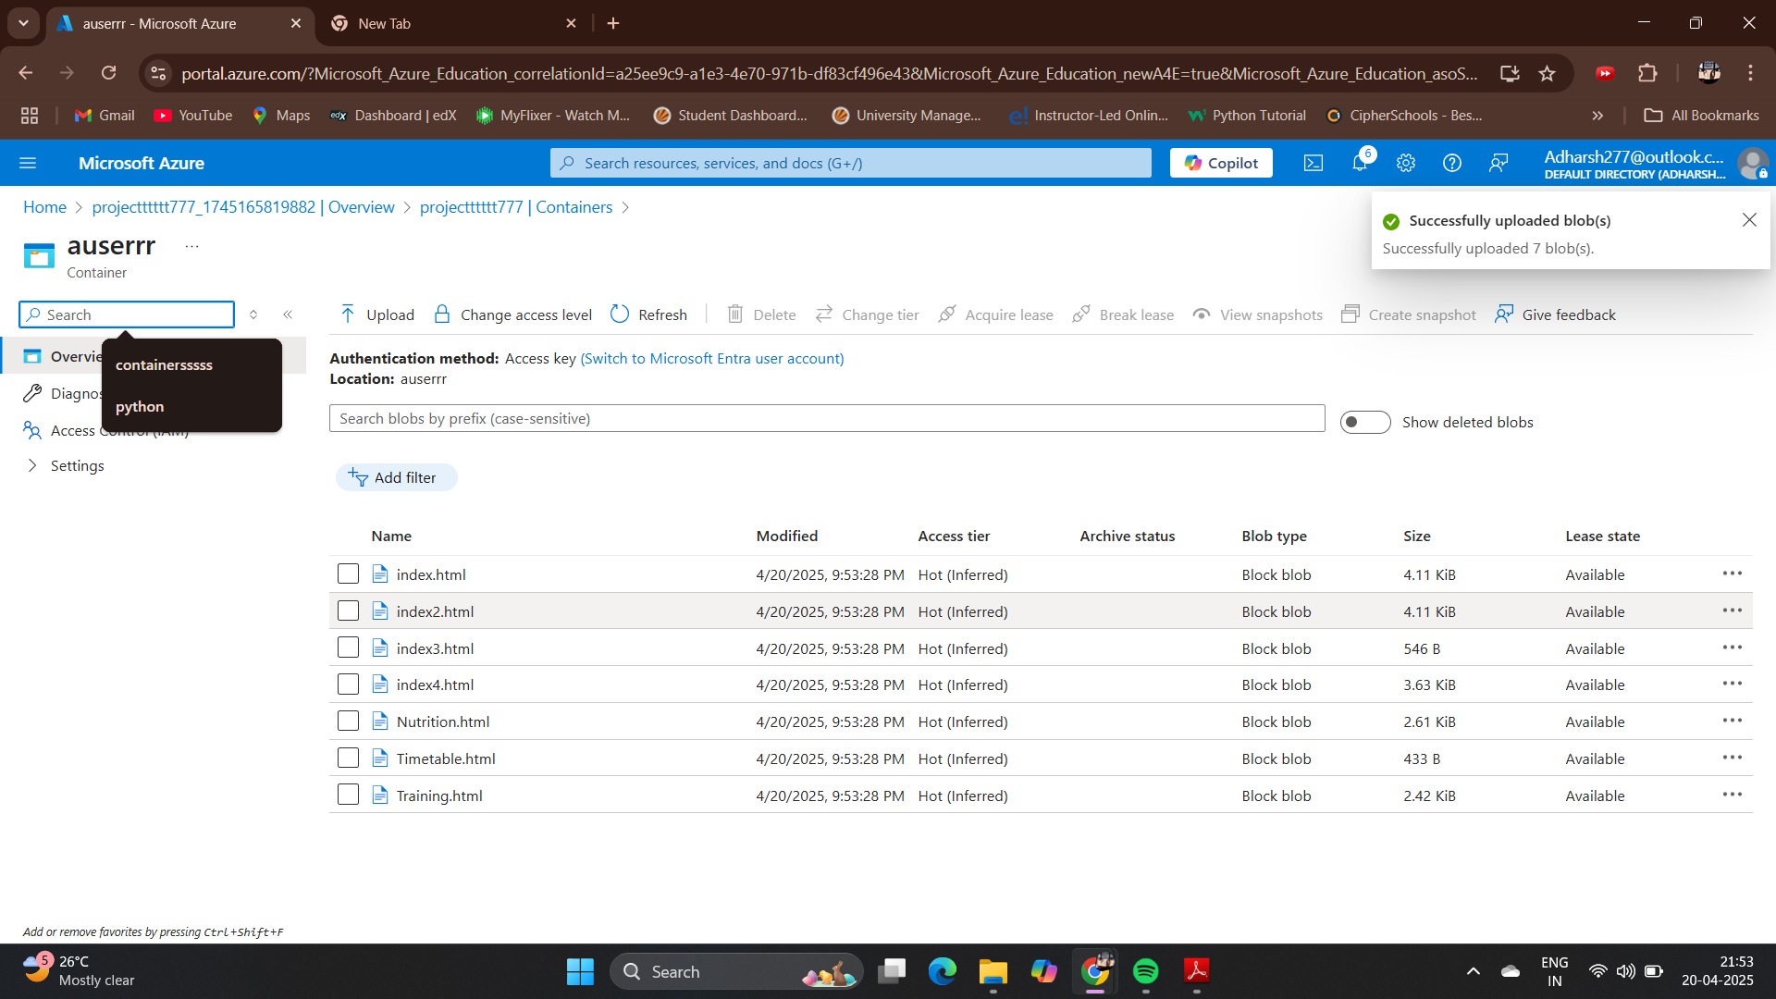

Tech Stack
Our website leverages a modern tech stack for optimal performance and scalability. The front end is built with HTML, CSS, and JavaScript. PHP/Python handles server-side logic. The Blob Storage for hosting the website.
Steps to Host a Static Website on Azure Blob
Storage
Create a Storage Account
Enable Static Website Hosting
Upload Your Website Files
Get the Website URL

Slide 4
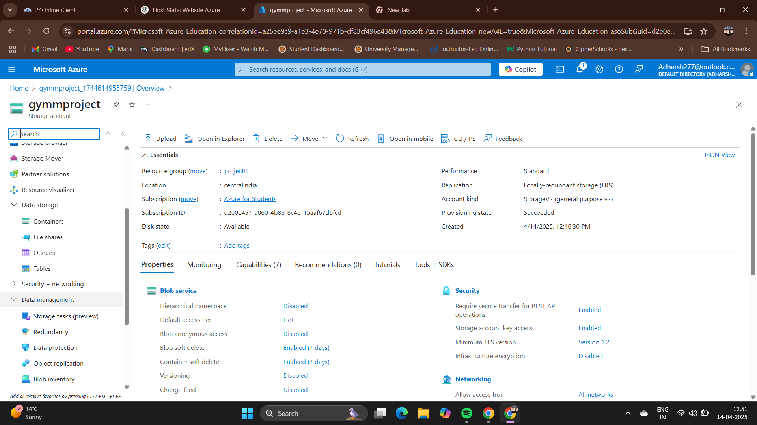
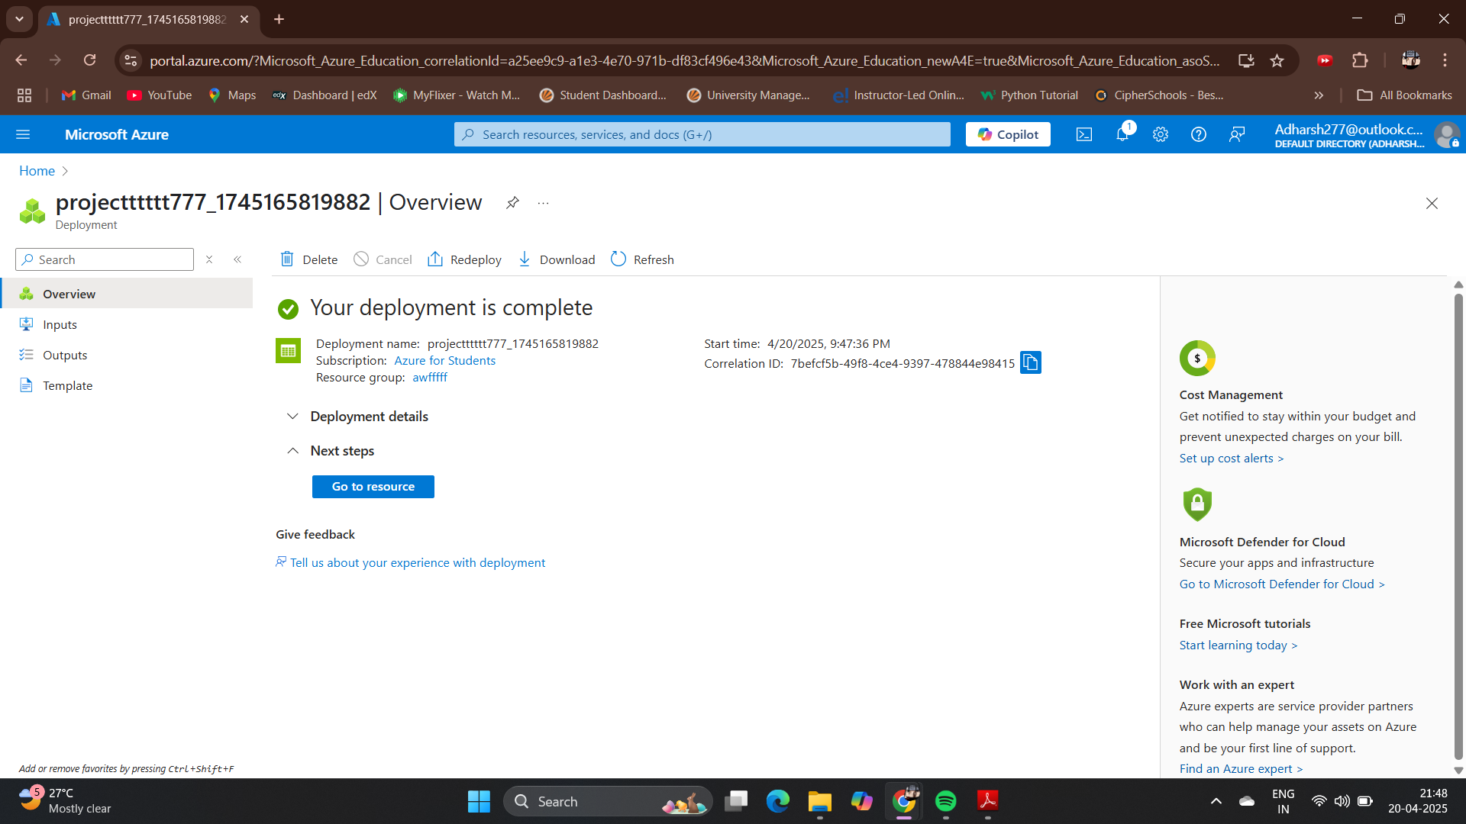

Slide 5
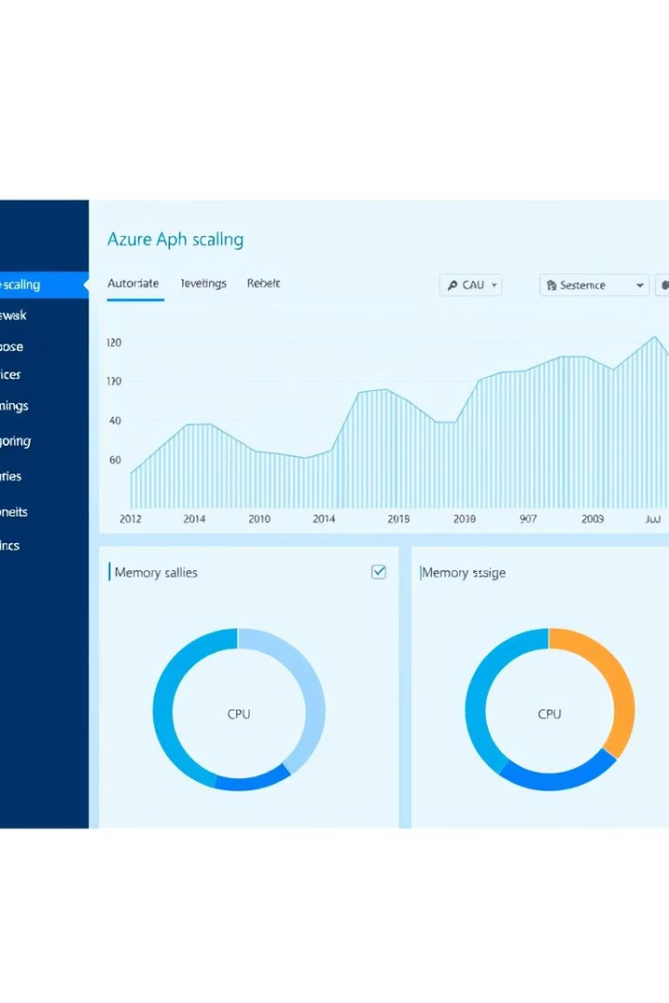



Azure Deployment
Azure App Service hosts the website, offering scalability and reliability. Auto-scaling is configured to handle traffic fluctuations. Azure Monitor tracks performance.
App Service
PaaS hosting
Auto-Scaling
Handles traffic

Slide 6
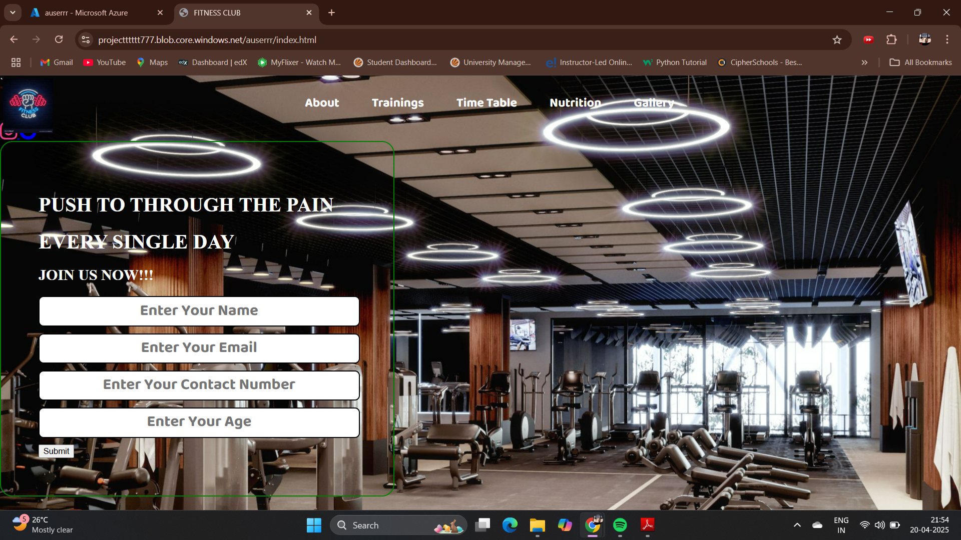


User Registration
User registration ensures secure account creation and management. It's implemented using PHP/Python and Azure SQL Database. Password hashing is performed using bcrypt. New users get an email verification link.
Password Hashing
Secure accounts
Account creation and management
bcrypt/Argon2
Email Verification
Process for new users

Slide 7
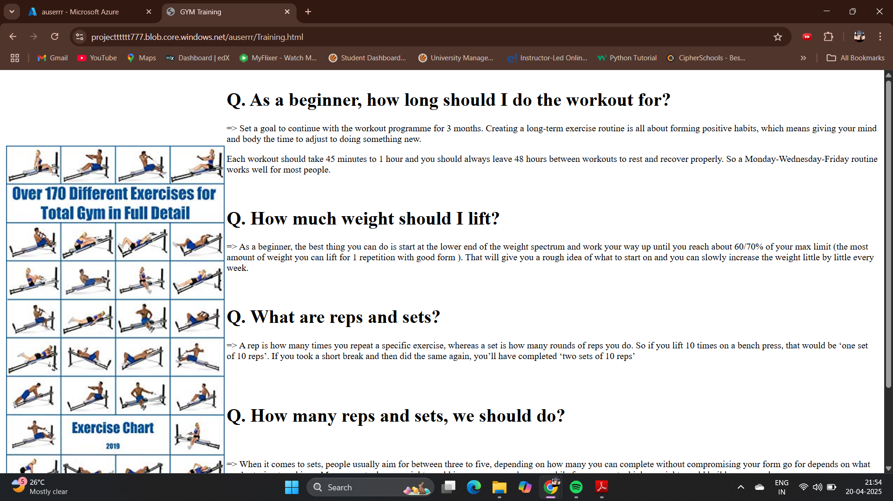
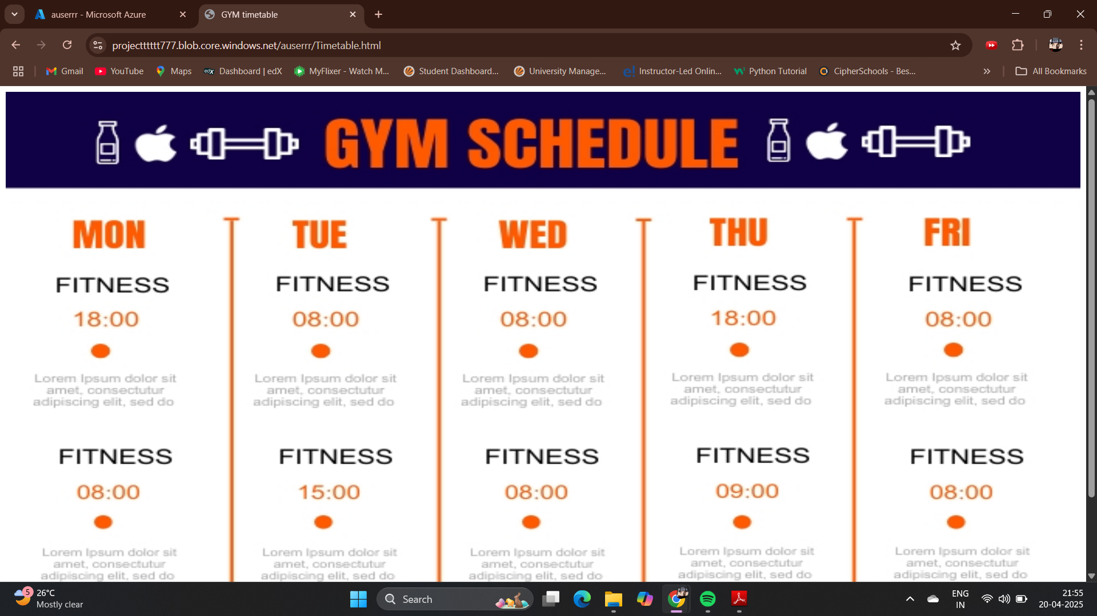


Workout Basics for Beginners
Workout Basics for Beginners
UI Screenshots: BAsics & Timetable
Start HERE
Timetable Page
Workout Basics For Beginners
Displaying scheduled events in a clear way.

Slide 8
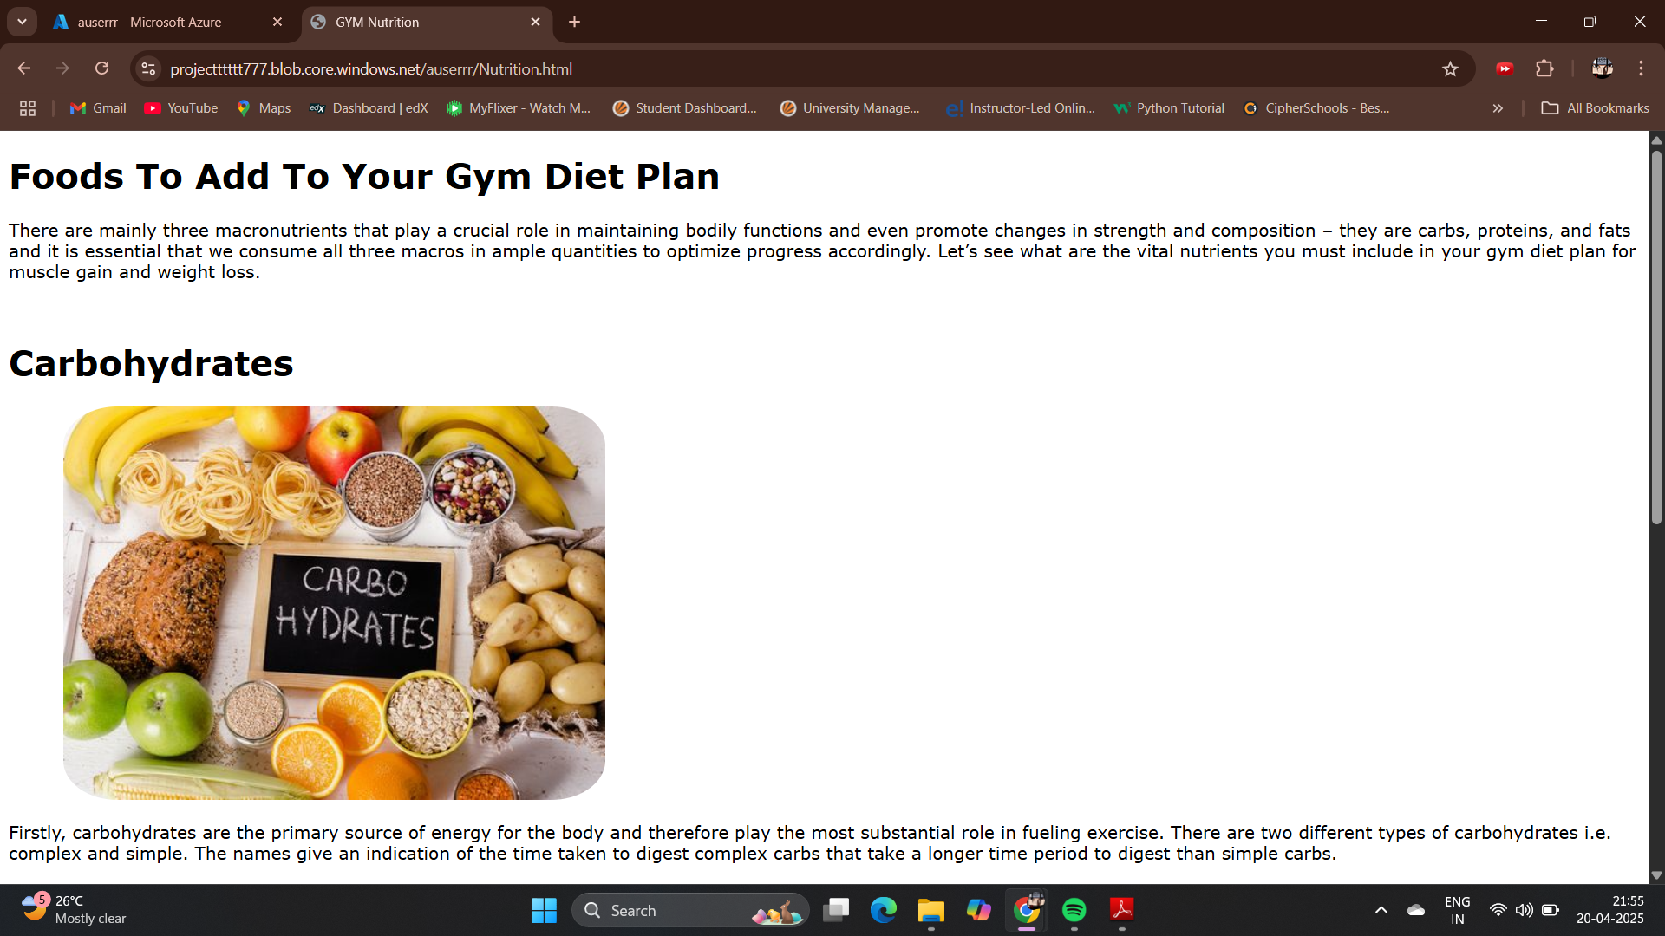
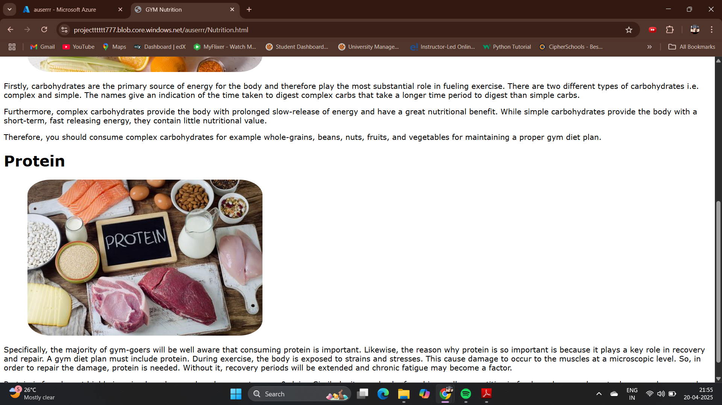

UI Screenshots: Nutrition
Nutrition Page
Gallery Page
Presenting clear, informative dietary content.
Showcasing visual content in an engaging way.

Slide 9


Conclusion
The project showcases Azure's scalability, reliability, and security for website hosting. Future enhancements may include CDN and Azure Cache. Project objectives were successfully achieved.
Azure Benefits
Scalability, reliability, security
Future
Implement CDN and Azure Cache

